Slide 1
Project Presentation
HALIT Wacim
SADOUNE Zakari
LOZA ARZE Mauricio Guillermo

Slide 2
What are the main subjects ?
Dimensionality’s (number of features) effect on performance for certain algorithms
Overfitting and regularization techniques
Model complexity and overfitting/underfitting

Slide 3
Question 01
How do ML-algorithms perform when applied to datasets with different levels of dimensionality, and what are the best dimensionality reduction techniques to improve performance ?

Slide 4
Synthetic data: create 3 realistic datasets of different dimensionalities
The algorithms: a neural network, logistic regression and randomForest classifier
Split the data and fit it to the models
How did we evaluate the performance ?
- 5 , 10 and 30 features
- Some noise
- Half the features are not important
- Not linearly separable

Slide 5
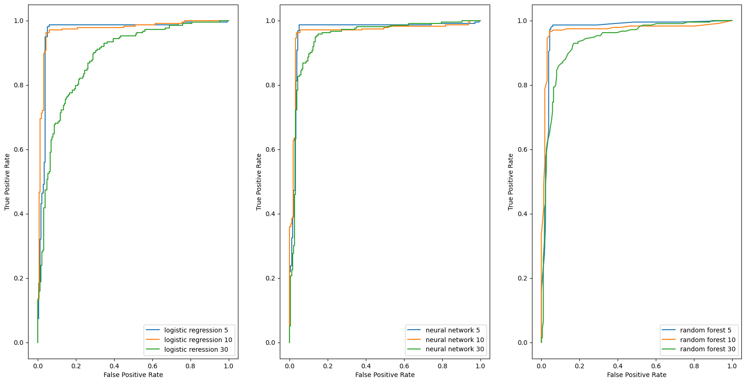
Evaluation techniques
Scikit Learn classification reports (f1-score)
ROC curves (TP rate vs FP rate)
What did we learn from the results ?

Slide 6
First results
Neural networks adapt the best to dimensionality changes
5/10 features generalizes better than 15/30
Non-important features affect the model drastically
LogisticRegression is the most sensitive to ‘’dimensional noise’’
The Curse of Dimensionality is real

Slide 7
Dimensionality reduction techniques
Briefly, we can classify them into two categories :
Feature Selection: remove non-important features
Feature Extraction: from a high-dimensional space to a lower one

Slide 8
Question 02
How does the choice of regularization techniques (such as L1 or L2 regularization, dropout, or early stopping) impact the extent of overfitting in various types of machine learning models?

Slide 9
Experiment setup
Four different synthetic datasets from the same target function.
Two different ML models.
Compare different regularization methods for in-sample and out-of-sample error.

Slide 10
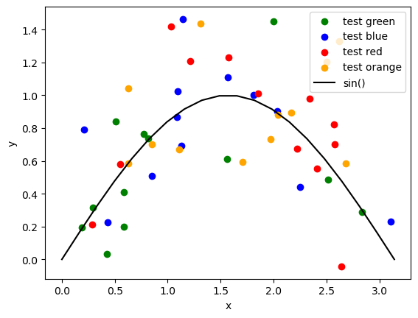
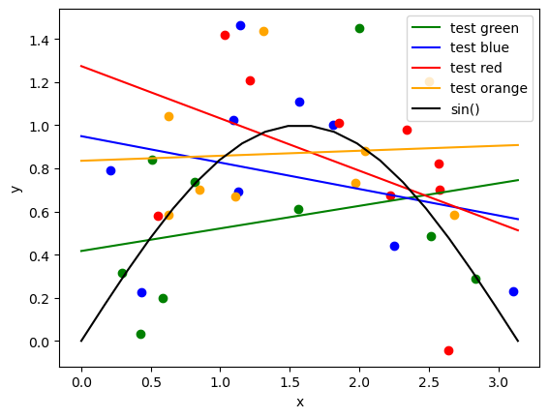
Linear regression

Slide 11
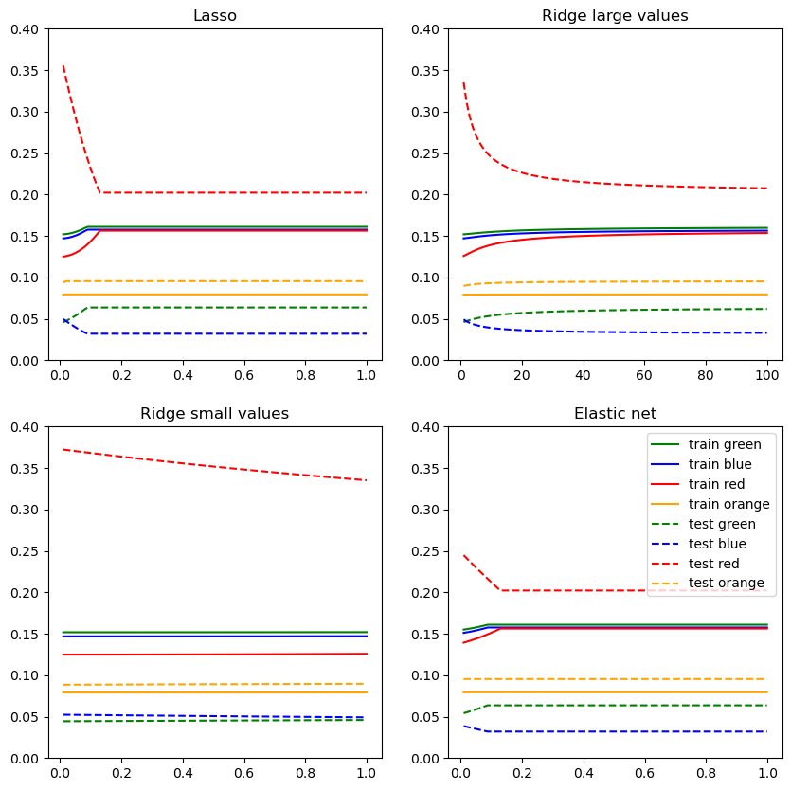
Linear regression
Cases:
Lasso - L1
Ridge - L2 with small values
Ridge – L2 with large values
ElasticNet - L1 + L2

Slide 12
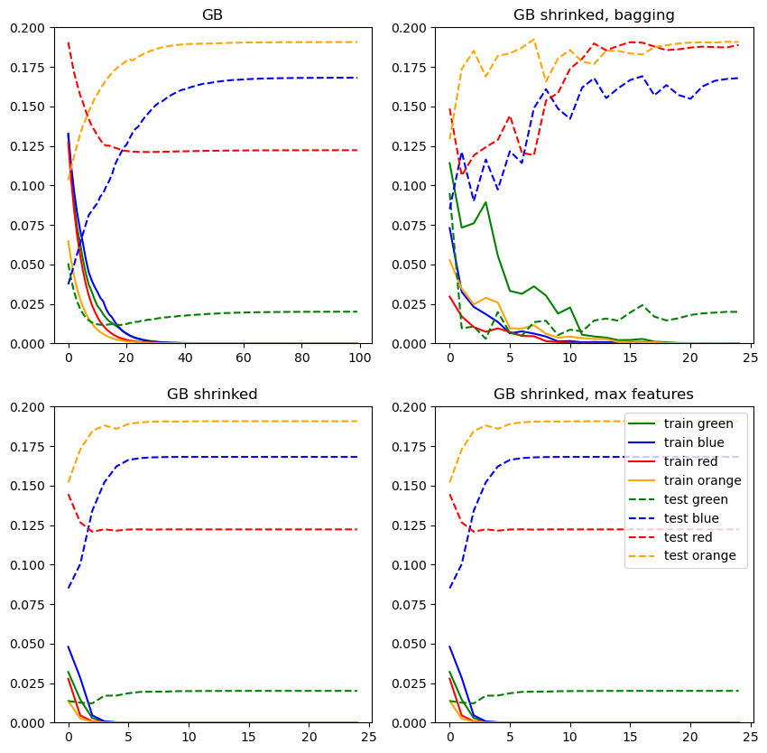
Gradient boosting
Cases:
No regularization
Shrinkage
Shrinkage + bagging
Shrinkage + max features

Slide 13
Conclusions
The efficacy of regularization can be affected by the input-data
It can increase or decrease generalization
There is a point where regularization no longer works
Boosting iterations reduce the effect of regularization terms

Slide 14
Question 03
How does the choice of model complexity in Random Forest and neural network models influence the risk of underfitting ?

Slide 15
How did we proceed
Real dataset : Fishmarket
Two models :
RandomForest : 03 configurations
Neural Networks : 02 configurations

Slide 16
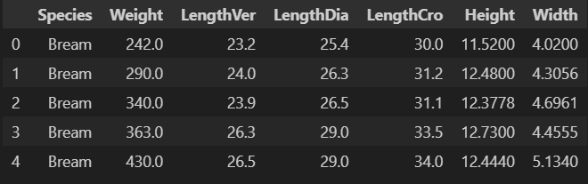
Dataset
Record of 07 different fishes
Perch, bream..etc
Goal: Predict the weight of a fish regarding specifities of his shape

Slide 17
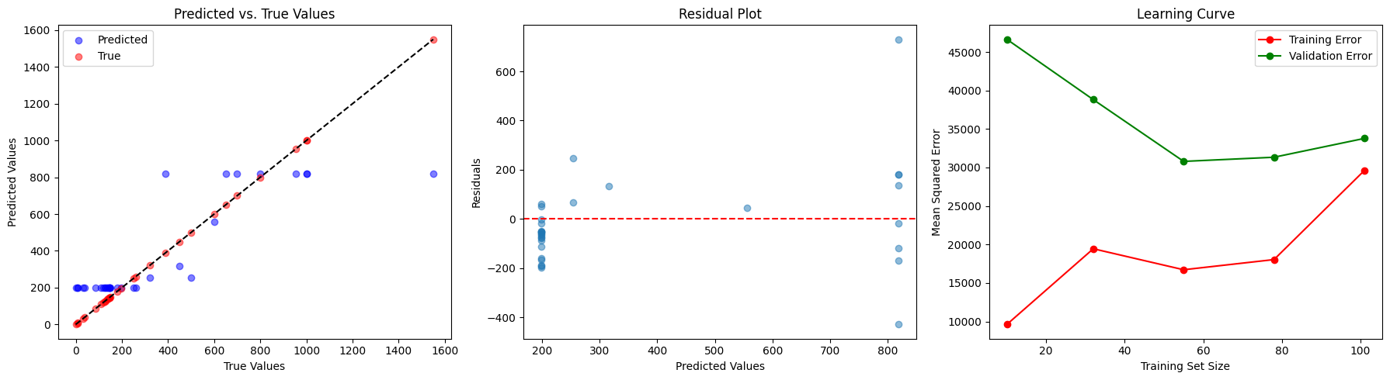
Random Forest
Estimators: 10
Maximum depth: 1
Random state: 5
Configuration 01

Slide 18
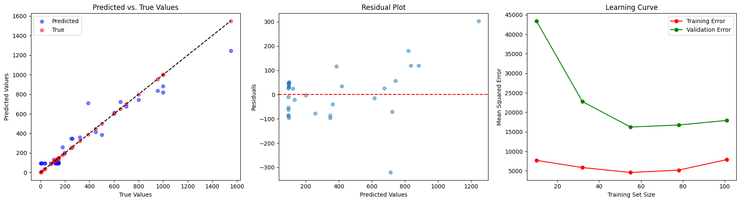
Random Forest
Estimators: 100
Maximum depth: 2
Random state: 42
Configuration 02

Slide 19
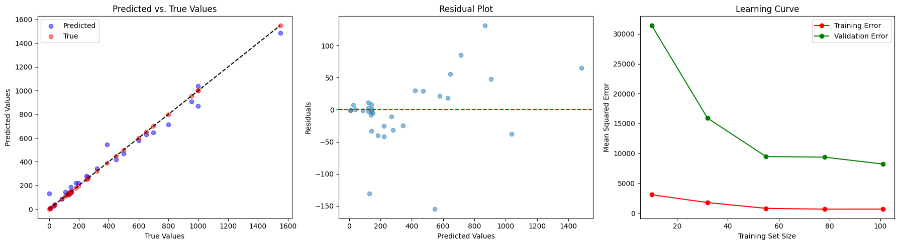
Random Forest
Configuration 03
Estimators: 500
Maximum depth: 15
Random state: 42

Slide 20
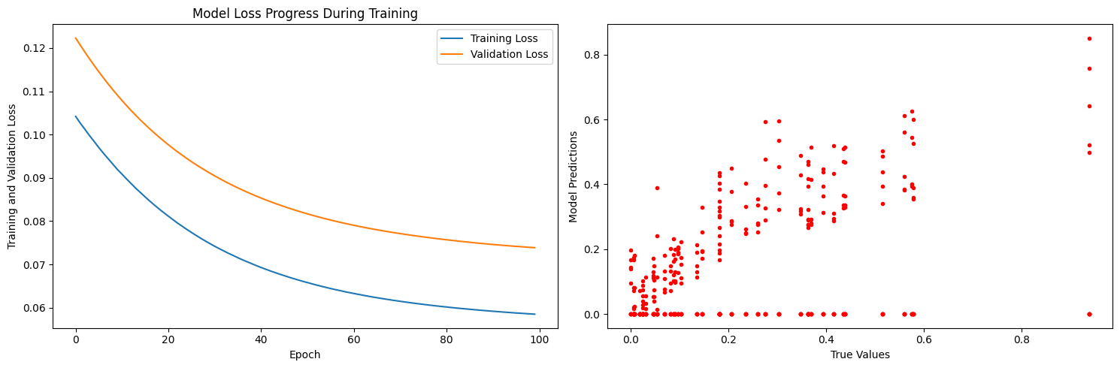
Neural Networks
Configuration 01
Hidden layers: 1
Neurons: 11

Slide 21
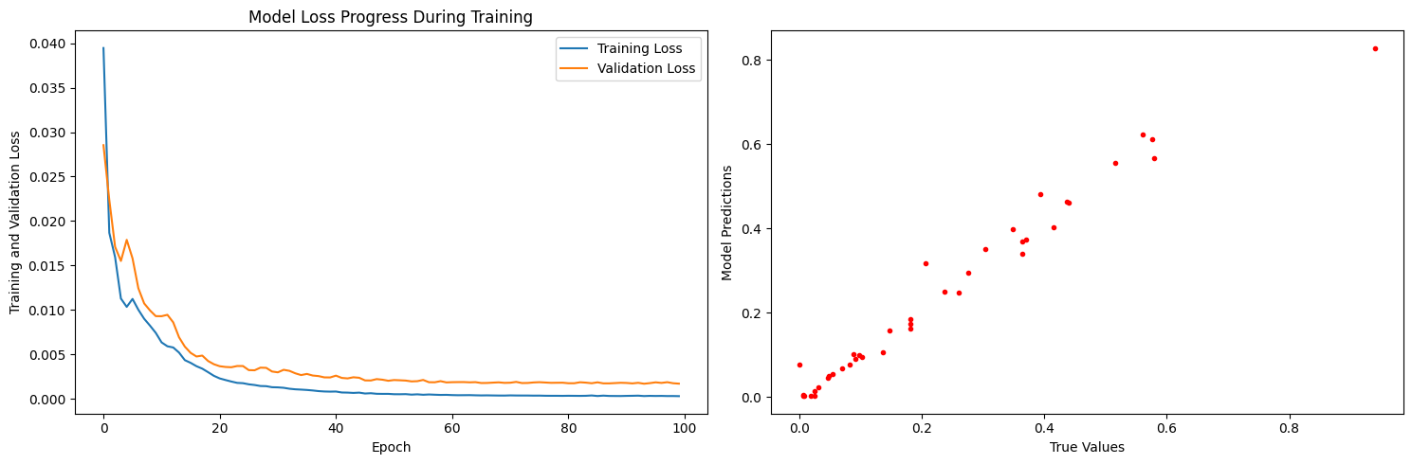
Neural Networks
Configuration 02
Hidden layers: 4
Neurons: 100,100,100,1

Slide 22
Conclusions
The simpler the model, the more difficult it is for it to capture patterns of the dataset
Balancing model complexity is important to prevent overfitting and underfitting.
The trade-off between model simplicity and capturing dataset patterns should be carefully considered when designing machine learning models.

